Slide 1
SPAIN:
High BW Data-Center Ethernet with Unmodified Switches
Jayaram Mudigonda, HP Labs Praveen Yalagandula, HP Labs
Mohammad Al-Fares, UCSD Jeff Mogul, HP Labs

Slide 2


Traditional Datacenter
Internet
Datacenter Fabric
Internet-facing applications:
E-Mail, Web Servers, etc.

Slide 3




DC Trends
HPC Applications
Information Explosion
Application Consolidation
Virtualization

Slide 4
DC Trends
Shuffle phase of Map – Reduce
Internet
M
R
Datacenter Fabric
M
R
R
M
M
R
R
M
M
R
R
M
R
M
R
M

Slide 5
DC Trends
Shuffle phase of Map – Reduce
Internet
M
R
Datacenter Fabric
M
High bisection bandwidth
R
R
M
M
R
R
M
M
R
R
M
R
M
R
M

Slide 6

DC Trends
Internet
Datacenter Fabric
Flat Network

Slide 7
DC Fabric Goals
High bisection BW
Flat network
Low-cost

Slide 8
Ethernet: a good choice
Commodity ➔ Inexpensive
Speeds:
10G is here
40G/100G soon
Flat-addressing
Self-configuring

Slide 9
But wait…

Slide 10
Spanning Tree Protocol (STP) makes Ethernet hard to scale!

Slide 11
Spanning Tree Protocol (STP)
Bandwidth bottleneck
Root
Unused links

Slide 12
Proposal 1:
High-port core switch
A common current approach

Slide 13
Expensive Core Switch
High BW or Multiple Links

Slide 14
Proposal 2: L3
IP Subnetting
VL2 [SIGCOMM’09]

Slide 15

L3 routers
Expensive
No non-IP protocols (FCoE)

Slide 16
Proposal 3: Modify switches (HW/SW)
TRILL [IETF]
SEATTLE [SIGCOMM’08]
PortLand [SIGCOMM’09]
Not deployable today!

Slide 17
SPAIN
Unmodified L2 switches
Multi-pathing
Arbitrary topologies

Slide 18
SPAIN Approach
Multi-pathing via VLANs
+
End-host driver to spread load

Slide 19
Multi-pathing via VLANs
Default VLAN
A
C
B
D

Slide 20
Multi-pathing via VLANs
Default VLAN
A
C
B
D

Slide 21
SPAIN
Unmodified L2 switches
Multi-pathing via VLANs
Arbitrary topologies
Minor End-host modifs
Low-cost
High-BW
DC Fabric
Today!

Slide 22
Outline
Introduction
SPAIN Components
Offline computation
End-host driver
Evaluation
Summary

Slide 23
Outline
Introduction
SPAIN Components
Offline computation
End-host driver
Evaluation
Summary

Slide 24
Offline Computation
Steps:
1. Discover topology
2. Compute paths
3. Layout paths as VLANs

Slide 25

Discover topology
SNMP Queries
SPAIN

Slide 26
Compute paths
Goal: leverage redundancy; improve reliability
Challenges: large graphs;
more paths➔more resources

Slide 27
Compute paths
Only consider paths between edge-switches
Modified Dijkstra’s; Prefer edge-disjoint paths

Slide 28
VLAN Layout
Simple scheme: Each Path as VLAN

Slide 29
But…
IEEE 802.1Q:
VLAN ID = 12 bits
➔ 4096 VLANs!

Slide 30
VLAN Layout
Simple scheme: Each Path as VLAN
Scales to only few switches

Slide 31
VLAN Layout
Our approach: 1 VLAN for a set of paths

Slide 32
Challenge:
Minimize VLANs
NP-Hard for arbitrary topologies

Slide 33
VLAN Layout
Heuristics:
1. Greedy path packing
2. Parallel graph-coloring

Slide 34
VLAN Layout
# VLANs = 4

Slide 35
Outline
Introduction
SPAIN Components
Offline computation
End-host driver
Evaluation
Summary

Slide 36
SPAIN End-host Driver
SPAIN
A
B

Slide 37
SPAIN End-host Driver
SPAIN
Topology & VLANs
A
B

Slide 38
SPAIN End-host Driver
1
Flow Table
Flow Table
1
2
2
A➔B, 1 : RED
A➔B, 2 : BLUE
A
B

Slide 39
Challenges
Link & switch failures
Pathological flooding
Interoperability
Host mobility
Load-balance
End-host state

Slide 40
Failures
Flow Table
Flow Table
A➔B : RED
A
B

Slide 41
Pathological Flooding
Does not know the location of B
Flow Table
Flow Table
A➔B : RED
B➔A : GREEN
A
B

Slide 42
Solution:
Chirping

Slide 43
Chirping
Knows the location of B
Does not know the location of B
Flow Table
Flow Table
C
A➔B : RED
B➔A : GREEN
A
B

Slide 44
Chirping
Flow Table
Flow Table
A➔B : RED
BLUE
B➔A : GREEN
A
B

Slide 45
Outline
Introduction
SPAIN Components
Offline computation
End-host driver
Evaluation
Summary

Slide 46
Evaluation
Simulations
Real testbed

Slide 47
Simulations
Topologies:
CiscoDC
Core switches
Aggregation modules
m = 2
Access switches per module
a = 2

Slide 48
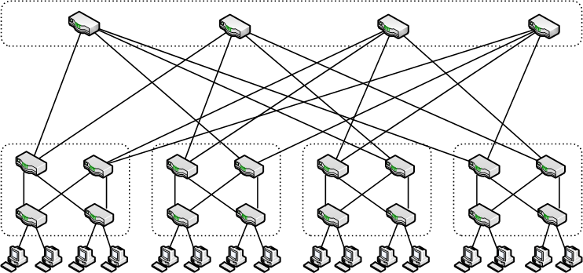
Simulations
Topologies:
CiscoDC
Fat-Tree
[Al-fares et al.
SIGCOMM’08]
#ports/switch
p = 4

Slide 49
Simulations
Topologies:
CiscoDC
Fat-Tree
[Al-fares et al.
SIGCOMM’08]
HyperX
[Ahn et al. SC’09]
2D HyperX k=4

Slide 50
Simulations
Topologies:
CiscoDC
Fat-Tree
[Al-fares et al.
SIGCOMM’08]
HyperX
[Ahn et al. SC’09]
B-Cube
[Guo et al.
SIGCOMM’09]
#ports/switch (p) = 2
Levels (l) = 2

Slide 51
Simulations
Topologies:
CiscoDC
Fat-Tree
[Al-fares et al.
SIGCOMM’08]
HyperX
[Ahn et al. SC’09]
B-Cube
[Guo et al.
SIGCOMM’09]
Metrics:
#VLANs Link-Coverage
Reliability Throughput

Slide 52
Simulations
Topologies:
CiscoDC
Fat-Tree
[Al-fares et al.
SIGCOMM’08]
HyperX
[Ahn et al. SC’09]
B-Cube
[Guo et al.
SIGCOMM’09]
Metrics:
#VLANs Link-Coverage
Reliability Throughput

Slide 53
Num. of VLANs
#VLANs
#switches
CiscoDC (8,8)
Fat-Tree (48)
HyperX (16)
B-Cube (48,2)
146
2880
256
2048
38
576
971
2048

Slide 54
Throughput
CiscoDC
Fat-Tree
HyperX
B-Cube
2x
24x
10.5x
1.6x
Improvement over STP

Slide 55
OpenCirrus Experiments

Slide 56
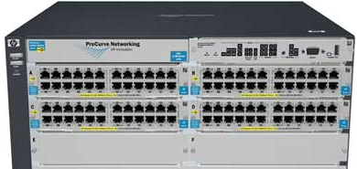
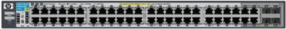
OpenCirrus Testbed
CORE SWITCH (CS)
10G
RACK SWITCH (RS)
1G
80 blades

Slide 57
OpenCirrus Testbed
CORE SWITCH (CS)
CS
10G
RACK SWITCH (RS)
S1
S2
S3
1G
80 blades

Slide 58
OpenCirrus Testbed
CS
S1
S2
S3
10G links that we added

Slide 59
OpenCirrus Testbed
CS
S1
S2
S3
4 VLANs

Slide 60
Shuffle-like experiment
Every server to all other servers
500MB data transfer

Slide 61
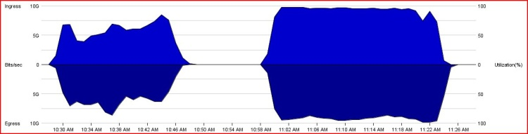
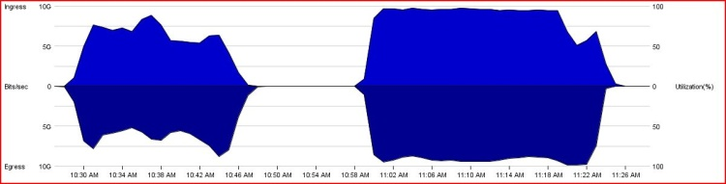
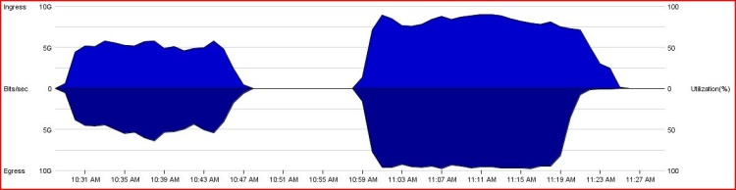
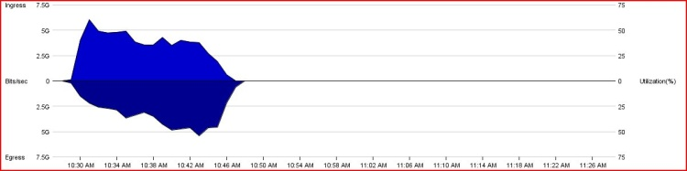
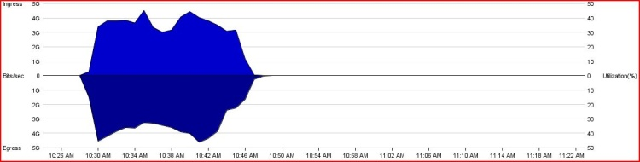
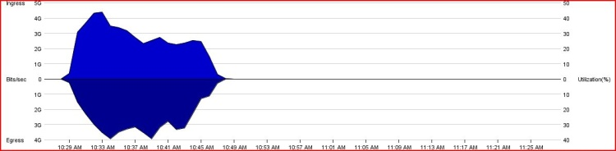
Spanning Tree Protocol(STP)
CS
S1
S2
S3

Slide 62
Link utilization in each direction
100%
0%
100%
Time

Slide 63
Spanning Tree Protocol(STP)
Over loaded
CS
S1
S2
S3
Unused

Slide 64
SPAIN
CS
No bottle-necks
S1
S2
S3

Slide 65
Completion times
~50% reduction

Slide 66
Aggregate Goodput (Gbps)
87% improvement

Slide 67
Aggregate Goodput (Gbps)
Incremental Deployability
% SPAIN hosts

Slide 68
Single Shortest Path(SSP) SEATTLE/TRILL
All flows on GRAY
CS
All flows on RED
All flows on GREEN
S1
S2
S3
SEATTLE/TRILL on unmodified switches with SPAIN

Slide 69
Comparison with SSP
16% better
7% better

Slide 70
SPAIN Take-away
Unmodified L2 switches
Multi-pathing via VLANs
Arbitrary topologies
Minor End-host modifs
Low-cost
High-BW
DC Fabric
Today!

Slide 71
Q&A

