Slide 1
Information Stewardship in the
Cloud: A Model-based Approach
David Pym ⁽¹⁾
Martin Sadler ⁽²⁾
Simon Shiu ⁽²⁾
Marco Casassa Mont ⁽²⁾
⁽¹⁾ University of Aberdeen, Scotland, UK
⁽²⁾ Cloud & Security Lab, HP Labs, Bristol, UK
CloudComp 2010
26-28 October 2010

Slide 2
Outline
Background on Cloud Computing
Information Stewardship in the Cloud
Relevant Scenarios
Towards a Rigorous Model-based Approach
Conclusions

Slide 3
Outline
Background on Cloud Computing
Information Stewardship in the Cloud
Relevant Scenarios
Towards a Rigorous Model-based Approach
Conclusions

Slide 4
Cloud Computing: Definition
No Unique Definition of Cloud Computing …
  NIST (NIST 2009) Proposal
Different Perspectives & Focuses (Platform, SW, Service Levels…)
Various Flavours:
  Computing and IT Resources Accessible Online
  Dynamically Scalable Computing Power
  Virtualization of Resources
  Access to (potentially) Composable & Interchangeable Services
  Abstraction of IT Infrastructure
  → No need to understand its implementation: use Services & their APIs
  Related “Buzzwords”: Iaas, PaaS, SaaS, EaaS, …
  Some current players, at the Infrastructure & Service Level:
  Salesfoce.com, Google Apps, Amazon, Yahoo, Microsoft, IBM, HP, etc.

Slide 5
Cloud Service Layers
Service Users
Service
Providers
Cloud End-User Services (SaaS)
Cloud Platform Services (PaaS)
Cloud
Providers
Cloud Infrastructure Services (IaaS)
Physical Infrastructure
Source: HP Labs, Automated Infrastructure Lab (AIL), Bristol, UK - Peter Toft

Slide 6
Cloud Computing: Models
Cloud
Provider #1
On Demand
CPUs
Printing
Service
CRM
Service
Office
Apps
Data
Storage
Service
User
…
Enterprise
Cloud
Provider #2
Backup
Service
Service
ILM
Service
Employee
Service
Service 3
Service
Business
Apps/Service
…
…
The
Internet
Internal Cloud
…

Slide 7
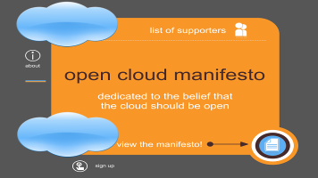


Cloud Computing: Initiatives
Recent General Initiatives aiming at Shaping Cloud Computing:
Open Cloud Manifesto
  Making the case for an Open Cloud
Cloud Security Alliance
  Promoting Best Security Practices for the Cloud
Jericho Forum
  Cloud Cube Model:
  Recommendations & (Security) Evaluation
  Framework
ENISA
  Whitepapers analysing Risks and Threats …
- …

Slide 8
Characterising Cloud Computing
Multiple Stakeholders
  End-users
  Organisation’s Decision Makers
  IaaS, PaaS, SaaS Providers
Analogy in the Cloud of what happens in the traditional IT Supply-Chain Model
Implications
  Business, Security and Risk
  Decision Making moving away from Centrally Controlled IT and Security …

Slide 9
Outline
Background on Cloud Computing
Information Stewardship in the Cloud
Relevant Scenarios
Towards a Rigorous Model-based Approach
Conclusions

Slide 10
Information Stewardship
It Accounts of what it means to Take Appropriate Care of Information Resources
Usually framed in terms of:
  Security
  Privacy
Information Stewardship involves:
  Multiple stakeholders: risk managers, lawyers, business, operational,
  IT security, compliance, etc.
  Duties and Obligations

Slide 11
Today’s Information Stewardship Lifecycle
Governance and Risk -> Develop Policy - > Technology and Operations -> Infrastructure -> Risk, Assurance and Compliance ->
Policy, process, people, technology
& operations
Economics/
Threats/
Investments
Information
Stewardship
Lifecycle
Assurance &
Situational Awareness
Trusted Infrastructure

Slide 12
Core Aspects and Issues of Information Stewardship Lifecycle
Multiple Roles
Different Views & Levels of Responsibility:
  “Object-level View”: Community responsible for stewardship, defining the constraints and restrictions imposed on other individuals and how systems operate
  “Meta-level View”: Responsibilities of the community to look-after the information assets of an organisation
Inability, for many organisations, to execute this lifecycle efficiently
  Involves Different “Languages”, Perspectives and Drivers/Priorities
  Execution Gaps
  IT Security sometimes is perceived as Getting in the Way …

Slide 13
Moving Towards The Cloud
Organisations currently struggle to evaluate the involved security risks in traditional centralised environment
  Usage of External Consultants to Assess Risks
Already engaging in various forms of outsourcing and Managed Services to help with operational aspects of IT, e.g. Supply Chain
Moving towards the Cloud:
  Potential Cost reduction and Increase of Agility/Productivity
  Potential Increase in Risks
  Loss of overall Sense of where Responsibilities Lie …
Governance and Risk -> Develop Policy - > Technology and Operations -> Infrastructure -> Risk, Assurance and Compliance ->
Information
Stewardship
Lifecycle

Slide 14
Implications of Stewardship in the Cloud Ecosystem
Governance and Risk -> Develop Policy - > Technology and Operations -> Infrastructure -> Risk, Assurance and Compliance ->
Governance and Risk -> Develop Policy - > Technology and Operations -> Infrastructure -> Risk, Assurance and Compliance ->
Governance and Risk -> Develop Policy - > Technology and Operations -> Infrastructure -> Risk, Assurance and Compliance ->
Service
Consumer
SaaS
Provider
PaaS
Provider
Key aspects of the Information Stewardship Lifecycle Operated by 3rd Parties
Each aaS Provider has their own lifecycle which might not align with the SaaS Consumer
Huge potentials for Misalignments and Miscommunication … Multiple Risks …
How to Provide Support?

Slide 15
UK Government Funded Collaborative Research
Trust Economics:
  Economics, Maths Foundations, Cognitive Science & Human Factors → Today’s CISO/Enterprise
  UCL, Newcastle University, Bath University, (Merrill Lynch in transition to National Grid), HP Labs
Cloud Stewardship Economics:
  Economics & System Modelling → Cloud Eco-Systems
  Aberdeen University, Bath University, IISP, Lloyds of London, Marmalade Box, Sapphire, Validsoft, HP Labs

Slide 16
Summary of Cloud Stewardship
Cloud
  Multiple stakeholders
  Complex Supply Chains
  Procurement Challenges
Stewardship
  Where Information is
  Who is Accountable and Responsible
  Who Can See or Change Information
  Assurance
  Liability (with longevity)
Economics
  Multiple stakeholders with different priorities (“utility functions”)
  Multiple incentives. How to identify the suitable trade-offs? How to provide Decision Support?

Slide 17
Outline
Background on Cloud Computing
Information Stewardship in the Cloud
Relevant Scenarios
Towards a Rigorous Model-based Approach
Conclusions

Slide 18
Relevant Scenarios
Enterprise Cloud Consumer (IT)
  Enterprise Leveraging the Cloud to Outsource Part of their IT operations & Consume Services
Service Providers
  Directly Provide end-to-end solutions/services or …
  Leverage a supply-chain in the Cloud: Stewardship …
Platform Service Providers (e.g. Amazon, MS Azure, etc.)
  Want to attract SaaS providers and Cloud Consumers to use their platforms
  This might lead them to do security well or focus on scale … Multiple incentives …
  Need to monitor for good security job …

Slide 19


Enterprise Cloud Consumer
Business
IT Dept
CISO/CIO
Public Cloud
staff
Fulfill
need
infrastructure
Private/
Community
Cloud

Slide 20
Service Providers in the Cloud
Multiple Options and Roles that can be Played by Service Providers:
Software
Solution
Software
Solution
Software
Solution
Software
Solution
In House
Services
Storage
Storage
Storage
CPU Service
CPU Service
Infrastructure &
Comms
Infrastructure &
Comms
CPU Service
Storage
Services
In the
Cloud
Infrastructure &
Comms
CPU Service
Infrastructure &
Comms

Slide 21
Key Aspects
Multiple Options
Multiple Trade-offs: Costs, Productivity/Agility, Security Risks, etc.
How to Support Strategic Decision Makers in making Informed Decisions?
Need to Understand the Economics of Cloud Stewardships
Need to Explore the Involved Risks and the Implications of Decisions
We Believe it is Important to Apply a Rigorous Scientific Approach to the Problem …
We are exploring this in the context of the “Cloud Stewardship Economics” Project …

Slide 22
Outline
Background on Cloud Computing
Information Stewardship in the CLoud
Relevant Scenarios
Rigorous Model-based Approach
Conclusions

Slide 23
Problems in the Area of Security Investments
Security Investments affect multiple outcomes: budget, confidentiality, integrity, availability, …
In most situations these outcomes can only be predicted with high degrees of uncertainty
Often the outcomes are inter-related (trade-off) and the link to investments is poorly understood
Classical business justification/due diligence (Return on Security Investment, Cost Benefit Analysis) encourages these points to be glossed over

Slide 24
Towards Modelling Cloud Ecosystems
Need to Introduce a Scientific Rigorous Approach to the Analysis of the Problem and in Providing Decisions Support (as it happens in other fields)
Modelling Information Stewardship – i.e. understanding the flow of information in a highly distributed, multi-party system. Specifically:
    Economics Environments, Preferences and Policies – applying utility theory in information Security and Stewardship
    Modelling Technological Systems

Slide 25
High Level Modelling Approach

Slide 26
Modelling Economic Environment, Preferences and Policies [1/2]
Applying Utility Theory, as developed in the Macroeconomics contexts and Financial Economics
Provide an Expressive Framework for representing the Preferences of the Various Involved Stakeholders
Utility Function: U_{t} = w₁f₁ (u_{t} – u_{t}) + w₂f₂(z_{t} – z_{t})
- analogy: trade-offs between unemployment and inflation
Applying this to Information Stewardship …

Slide 27
Modelling Economic Environment, Preferences and Policies [2/2]
Applying this to Information Stewardship:
Organisation exists in an economic and/or regulatory environment
The manager (stakeholder) formulates a utility function expressing their policy preferences e.g. stating different priorities in terms of security risks, productivity, agility, privacy, etc.
In such a complex context, it would be hard to formulate system equations (as in macroeconomics modelling) but at least identify the key control variables
Use an Executable System Model, based on these key control variables, to simulate the dynamics of the “utility function” …

Slide 28
Modelling Systems
- Use a Rigorous, Mathematical Approach to Model:
  Processes
  Resources
  Location
  Environment
- Identify Suitable Metrics and Proxy Measures to Convey Preferences
Monte Carlo Simulations based on the Model, to explore various options and carry out “What-If” analysis
Developed the GNOSIS Modelling Toolset
  Discrete-event (probabilistic) Process Modelling & Simulation Framework and Toolset
Applied in the Context of Security Analytics

Slide 29
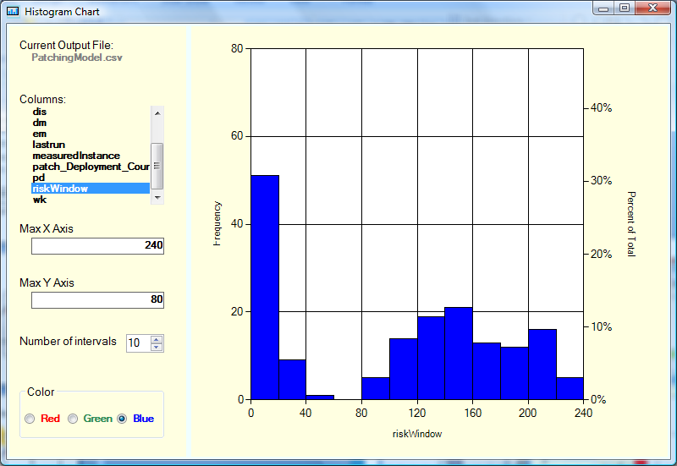
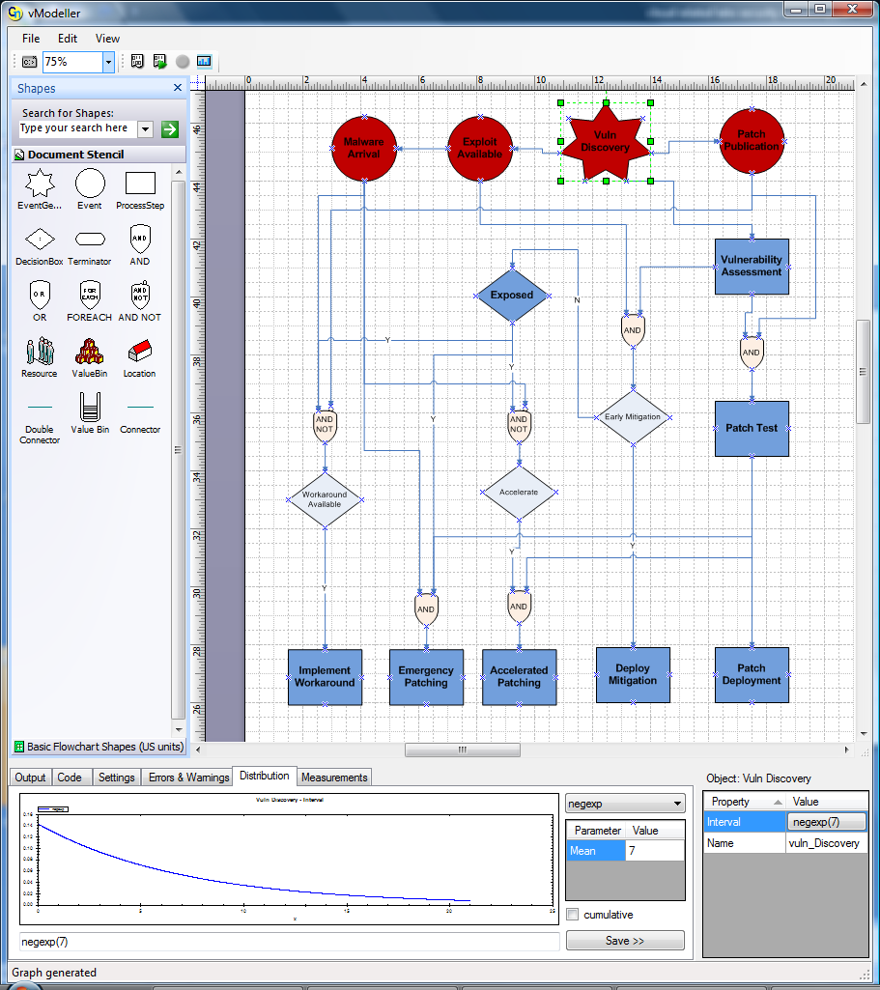
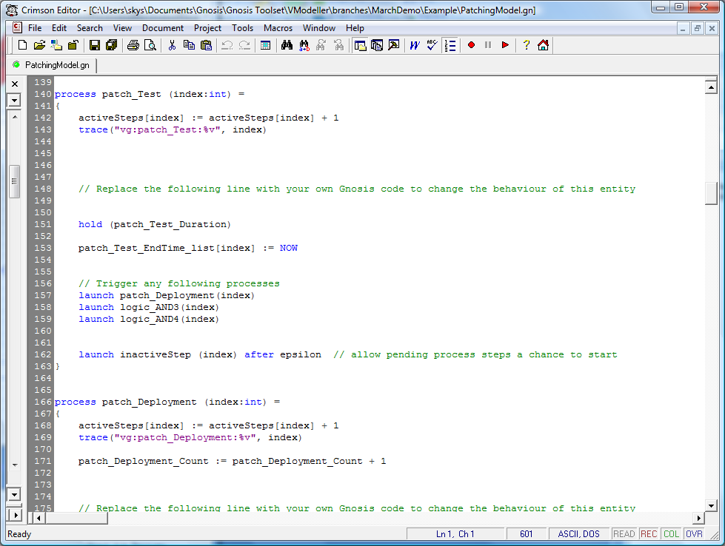
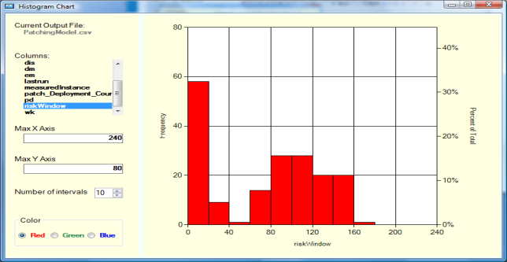
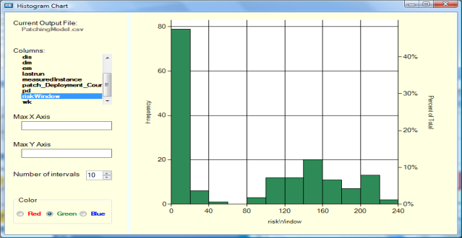
Current Risk Window
Security Analytics Tools
Risk Window with
Patch Investment
Generates
simulation/
Experiment
results
Risk Window with
HIPS investment
Generates code
for the underlying
Gnosis Engine

Slide 30
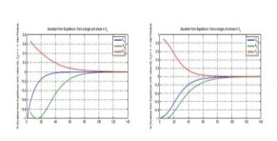
Security Analytics [1/2]
Economics/
Threats/
Investments
Policy, process, people, technology
& operations
Governance and Risk -> Develop Policy - > Technology and Operations -> Infrastructure -> Risk, Assurance and Compliance ->
Malware
Exploit
Available
Vulnerability
Disclosed
Patch
Available
Malware
Reports?
N
Exposed?
Vulnerability
Assessment
Y
N
Y
Test
Solution
Patch
Available?
Accelerate?
Early
Mitigation?
N
Y
Y
Y
Patch
Deployment
Workaround
Available?
Deploy
Mitigation
Accelerated
Patching
Y
Implement
Workaround
Emergency
Patching
Security
Analytics
Assurance &
Situational Awareness
Trusted Infrastructure
We Successfully Applied Security Analytics to Today’s Security Lifecycle …

Slide 31
Security Analytics [2/2]
Aiming at Leveraging and Extending Security Analytics in the Context
of Cloud Stewardship Economics
Aiming at Achieving this in the context of the Collaborative
“Cloud Stewardship Economics” Project …

Slide 32
Outline
Background on Cloud Computing
Information Stewardship in the Cloud
Relevant Scenarios
Rigorous Model-based Approach
Conclusions

Slide 33
Conclusions
Organisations already have challenges in operating their current information stewardship lifecycle
Additional challenges in the Cloud, as part of this Lifecycle will be operated by 3rd parties
Huge potentials for risks due to misalignments and misunderstandings as information is shared and related security practice
We argue for the need of a Model-based Understanding of Information Stewardship
Outstanding Challenges:
  Characterising Stewardship and Information Flow and Fitting it with System Modelling
  Integration of various modelling types, including economic, system/technological and policy/users
Work in progress in the context of the Collaborative “Cloud Stewardship Economics” Project …

Slide 34
Q&A
Marco Casassa Mont
HP Labs, Bristol, UK marco.casassa-mont@hp.com

